Slide 1
COS 212 Skip Lists

Slide 2
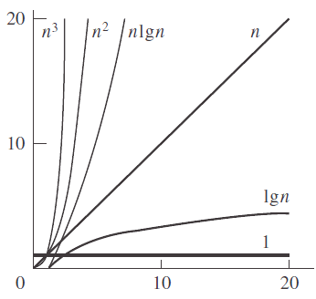
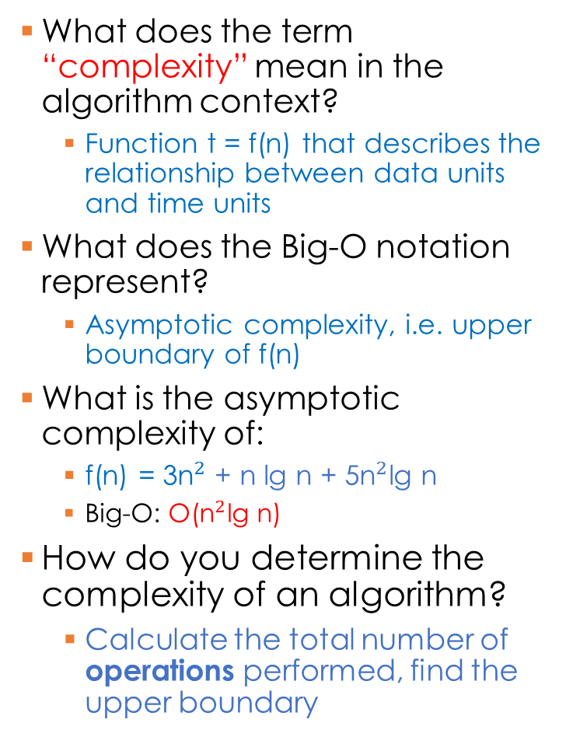
Big-O notation: recap
What does the term “complexity” mean in the algorithm context?
Function t = f(n) that describes the relationship between data units and time units
What does the Big-O notation represent?
Asymptotic complexity, i.e. upper boundary of f(n)
What is the asymptotic complexity of:
f(n) = 3${\text{n}}^{2}$ + n lg n + 5${\text{n}}^{2}$lg n
Big-O: O(${\text{n}}^{2}\text{lg} \text{n}$)
How do you determine the complexity of an algorithm?
Calculate the total number of operations performed, find the upper boundary
What does O(1) stand for?
Constant time: not dependent on the number of data units n
What is the complexity of the following code snippet?
for(i = 1; i <= n; i*=2)
System.out.println(i);
O(lg n)

Slide 3
Remember the Linked Lists?
public class SLLNode<T> { // template node class
public T data;
public SLLNode<T> next; // no pointers in Java!
public SLLNode() {
next = null;
}
public SLLNode(T el, SLLNode<T> p) {
data = el; next = p;
}
}
el
el
abbreviated as:

Slide 4
Singly Linked List
public class SLL<T> {
protected SLLNode<T> head, tail;
// methods:
. . . . . . . . . . .
}
head
2
8
3
\
tail
// methods:

Slide 5
Linked Lists
What types of linked lists do you know?
Singly linked
Doubly linked
Ordered (sorted elements)
Circular
Ordered circular doubly linked ☺
What disadvantage do all of these lists share?
Inefficient search
How inefficient?
Search always starts from the beginning/end of the list, and then executes sequentially
What is the complexity?
O(n)
No random access!

Slide 6
Skip Lists
Skip lists are ordered linked lists that enable efficient search
Built in layers
1st layer is the ordinary linked list structure
Each higher layer acts as an "express lane" for the lists below
When searching for an element, search starts at the highest level
If not found, or if you find an element > target, go to previous node, and then go one level deeper, repeat till element found
top level
null
null
null
null
head
1
2
3
4
5
6
7
8
9

Slide 7
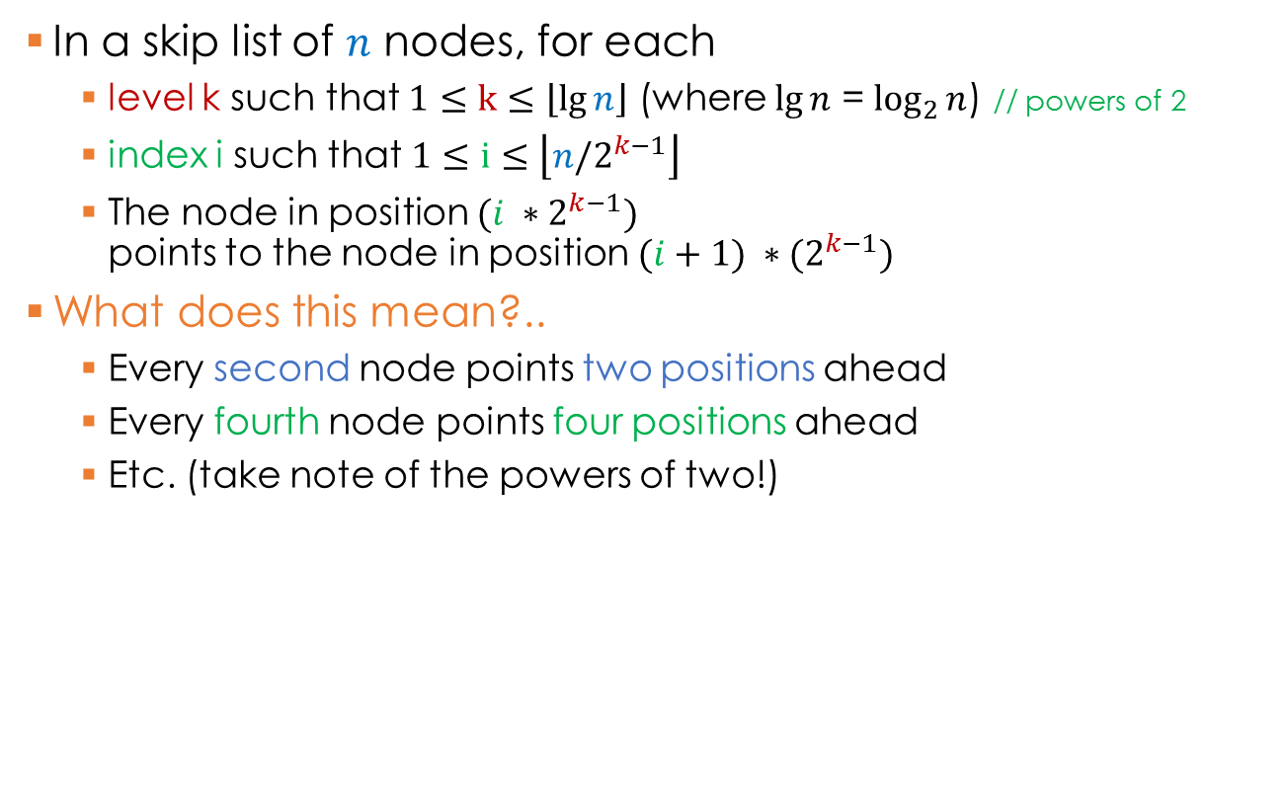
Math behind Skip Lists
In a skip list of $n$ nodes, for each
level k such that $1≤k≤\left\lfloor \lg{n}\right\rfloor$ (where $\lg{n}$ = $\log_{2}{n}$) // powers of 2
index i such that $1≤i≤\left\lfloor n/2^{k−1}\right\rfloor$
The node in position$(i ∗2^{k−1})$ points to the node in position $(i+1) ∗{(2}^{k−1})$
What does this mean?..
Every second node points two positions ahead
Every fourth node points four positions ahead
Etc. (take note of the powers of two!)
null
null
null
null
head
1
2
3
4
5
6
7
8
9

Slide 8
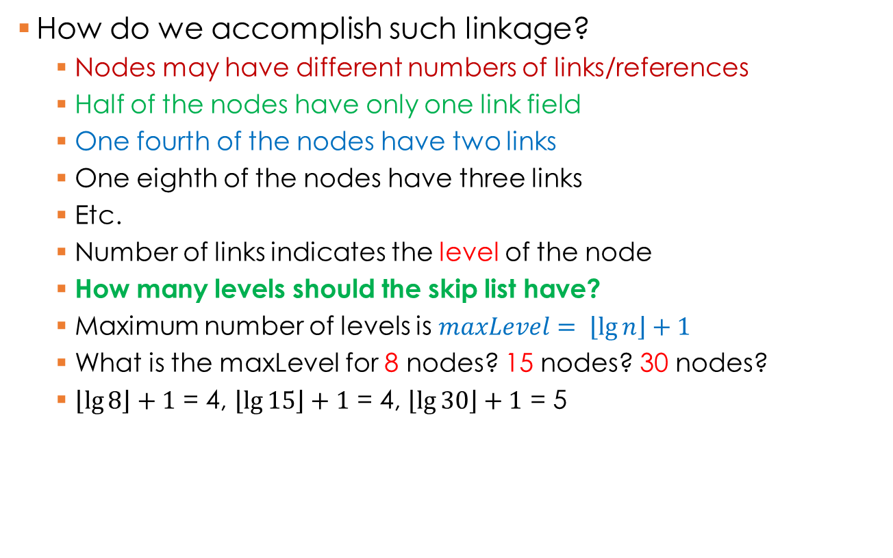
Skip Lists
How do we accomplish such linkage?
Nodes may have different numbers of links/references
Half of the nodes have only one link field
One fourth of the nodes have two links
One eighth of the nodes have three links
Etc.
Number of links indicates the level of the node
How many levels should the skip list have?
Maximum number of levels is $maxLevel= \left\lfloor \lg{n}\right\rfloor +1$
What is the maxLevel for 8 nodes? 15 nodes? 30 nodes?
$\left\lfloor \lg{8}\right\rfloor +1$ = 4, $\left\lfloor \lg{15}\right\rfloor +1$ = 4, $\left\lfloor \lg{30}\right\rfloor +1$ = 5
null
null
null
null
head
1
2
3
4
5
6
7
8
9

Slide 9
Skip Lists
How would you approach implementing a skip list?
Every node will need an array of “next” references
Size of the array will be determined by the level of the node
The head of the skip list will be an array of maxLevel size, so that any level could be directly accessed
null
null
null
null
head
1
2
3
4
5
6
7
8
9

Slide 10
Skip Linked Lists
public class SkipNode<T> { // template node class
public T data;
public SkipNode<T>[] next; // array!
public SkipNode(T val, int k) {
data = val;
next = new SkipNode[k]; // level k
for(int i = 0; i < k; i++) {
next[i] = null;
}
}
}
null
next
null
null
data
val

Slide 11
Skip Lists : Search
Start at the top level
For each level, iterate until:
The element is found (END search); or
The current element is greater than the target element; or
The end of the list is reached
If an element > target is found:
Go to previous node
Go one level down and go to (2)
If the end of the list is reached:
Go to previous node, decrement level until a non-null next link is found
If non-null next is found, set ptr = next and go to (2)
Otherwise, return false: element not found!
null
null
null
null
head
1
2
3
4
5
6
7
8
9

Slide 12
Search for 6:
Start at the top level
For each level, iterate until:
The element is found (END search); or
The current element is greater than the target element; or
The end of the list is reached
If an element > target is found:
Go to previous element
Go one level down
If the end of the list is reached:
Decrement level until a non-null link to the next element found
If non-null next is found, set ptr = next and go to (2)
Otherwise, return false: element not found!
How many nodes did we check?
Four nodes
Is it better than the standard linked list?
Yes! Efficiency?
O(lg n)
null
null
null
null
head
1
2
3
4
5
6
7
8
9
Code is provided in the textbook

Slide 13
Skip Lists : Insert
Searching skip lists is efficient
What about inserting nodes?
Maintaining the original structure (every second link points two steps ahead, every fourth points four steps ahead, etc.) is inefficient
Solution: instead of maintaining different level node positions, maintain the number of nodes on each level
null
null
null
null
head
1
3
5
6
8
10
17
21
99

Slide 14
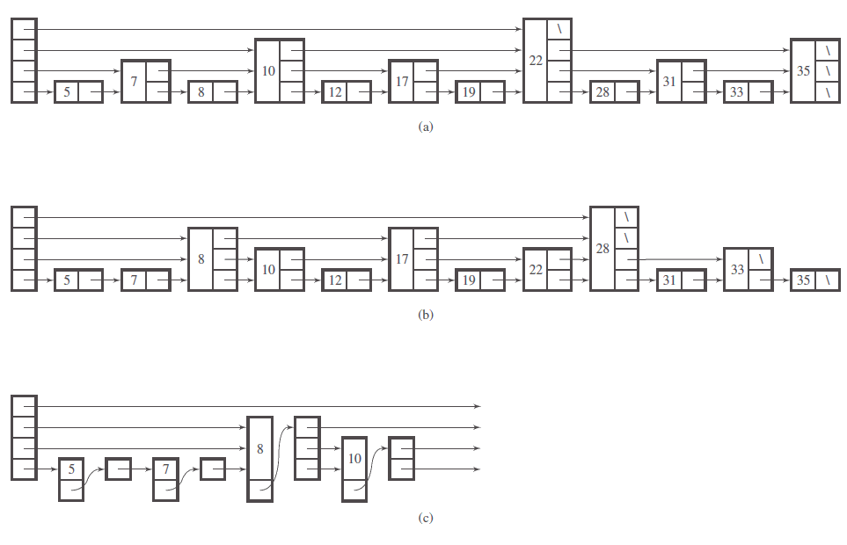
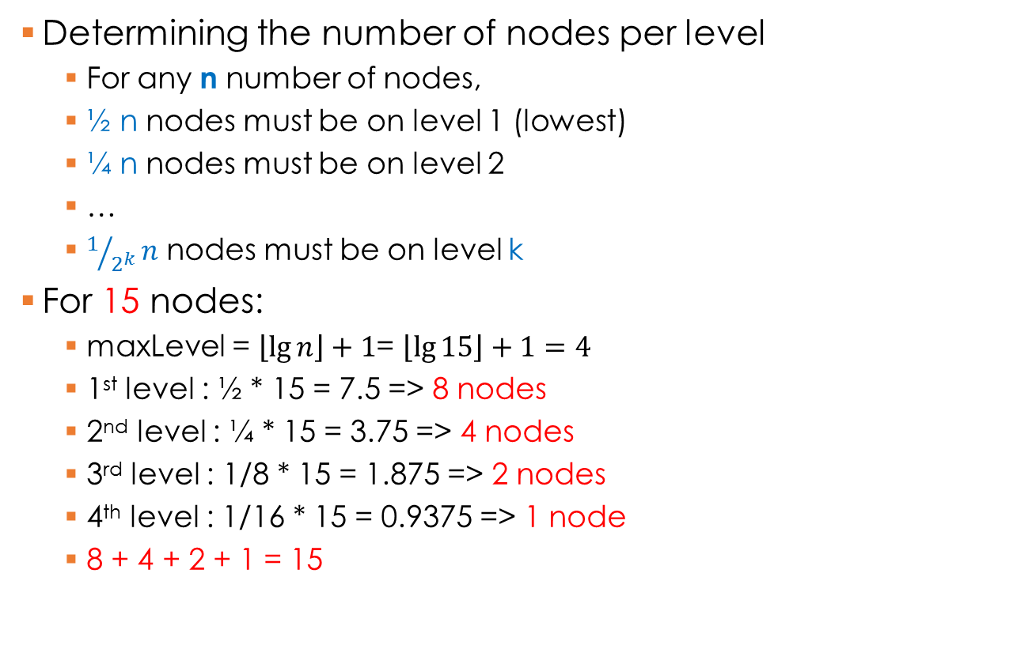
Skip Lists : Insert
Determining the number of nodes per level
For any n number of nodes,
½ n nodes must be on level 1 (lowest)
¼ n nodes must be on level 2
…
$1/{2^{k}}n$ nodes must be on level k
For 15 nodes:
maxLevel = $\left\lfloor \lg{n}\right\rfloor +1$= $\left\lfloor \lg{15}\right\rfloor +1=4$
1st level : ½ * 15 = 7.5 => 8 nodes
2nd level : ¼ * 15 = 3.75 => 4 nodes
3rd level : 1/8 * 15 = 1.875 => 2 nodes
4th level : 1/16 * 15 = 0.9375 => 1 node
8 + 4 + 2 + 1 = 15

Slide 15
Skip Lists : Insert
When a node is inserted, choose its level randomly
Generate a random number 1 <= r <= 15
Intervals represent probabilities
if (r < 9) choose level 1 (half of n)
if (r < 13) choose level 2 (quarter of n)
if (r < 15) choose level 3 (8th of n)
if (r == 15) choose level 4 (16th of n)
½ n
¼ n
1/8 n
1/16 n
1
9
13
15

Slide 16
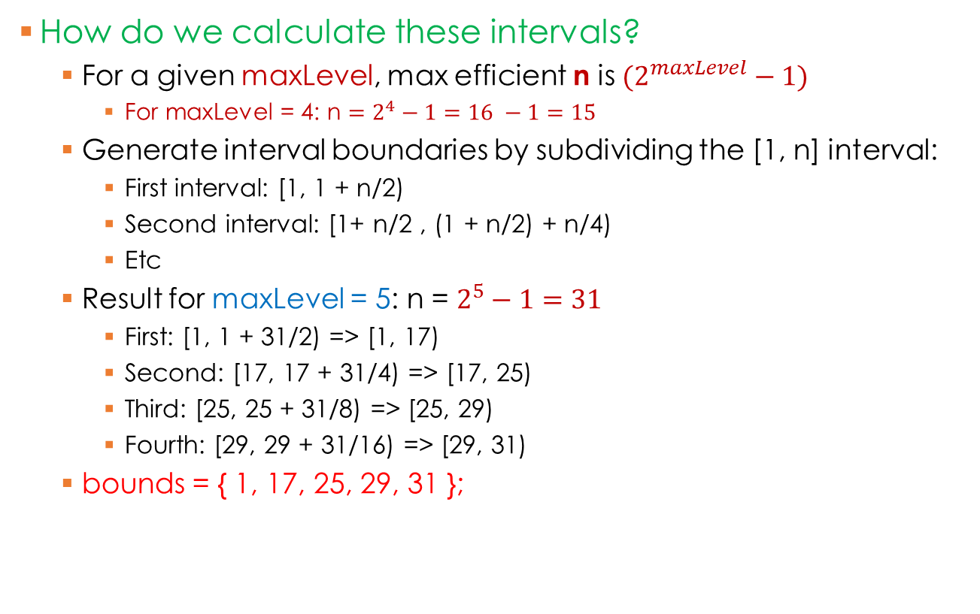
Skip Lists : Insert
How do we calculate these intervals?
For a given maxLevel, max efficient n is ${(2}^{maxLevel} − 1)$
For maxLevel = 4: n $=2^{4}−1=16 −1=15$
Generate interval boundaries by subdividing the [1, n] interval:
First interval: [1, 1 + n/2)
Second interval: [1+ n/2 , (1 + n/2) + n/4)
Etc
Result for maxLevel = 5: n = $2^{5}−1=31$
First: [1, 1 + 31/2) => [1, 17)
Second: [17, 17 + 31/4) => [17, 25)
Third: [25, 25 + 31/8) => [25, 29)
Fourth: [29, 29 + 31/16) => [29, 31)
bounds = { 1, 17, 25, 29, 31 };
½ n
¼ n
1/8 n
1/16 n

Slide 17
Skip Lists : Insert
Create a new node with a randomly generated level
For each level, find correct predecessor: Iterate until…
The current element is greater than the new node; or
The end of the list is reached
Once the correct predecessors are found:
Link the new node on each level using the predecessor and the predecessor’s next
Special cases:
No predecessors (smallest element)
No successors (last element)
Insert 15 on level 4:
predecessors?
successors?
null
null
null
null
head
1
3
5
6
8
10
17
21
99

Slide 18
Skip Lists : Delete
How would you remove an element from the skip list?
First of all, locate the element – use search algorithm
Find all predecessors on all levels
Update predecessors to point to the next elements of the node
null
null
null
null
head
1
3
5
6
8
10
17
21
99

Slide 19
Skip Lists : Delete
void delete(x) {
SkipNode node = search(x);
SkipNode[] prev = new SkipNode[node.level];// array of predecessors
SkipNode ptr = head[node.level - 1]; // start at the top level
for(int i = node.level – 1; i >= 0; i--) { // go through each level
while(ptr.next[i] != node) { // until predecessor is found…
ptr = ptr.next[i];
}
prev[i] = ptr;
} // end for
// Now, all predecessors are found – delete node!
for(int i = 0; i < node.level; i++)
prev[i].next[i] = node.next[i];
// Unlinking is sufficient: Java will take care of the memory ☺
}

